Slide 1

ASEN 5070
Statistical Orbit determination I
Fall 2012
Professor George H. Born
Professor Jeffrey S. Parker
Lecture 8: Stat OD Processes

Slide 2
Announcements
Homework 1 Graded
Comments included on D2L
Any questions, talk with us this week
Homework 2 CAETE due Today
Graded soon after
Homework 3 due Today
Homework 4 due next week

Slide 3
Homework 3
A few questions on Problem 4’s Laplace Transform.
There’s one Transform missing from the table:
Note: This has been posted in the HW3 discussions on D2L for a few days now. Check there if you have a commonly-asked question!

Slide 4
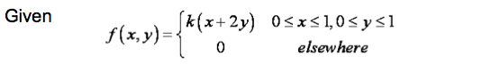
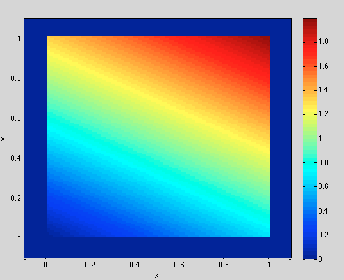
What does the joint density function MEAN?

Slide 5
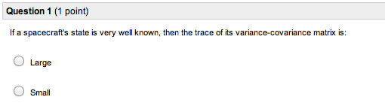
Quiz Results

Slide 6
Quiz Results

Slide 7
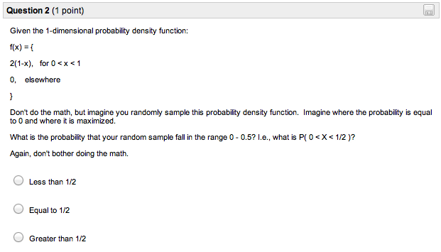
Quiz Results

Slide 8
Quiz Results

Slide 9
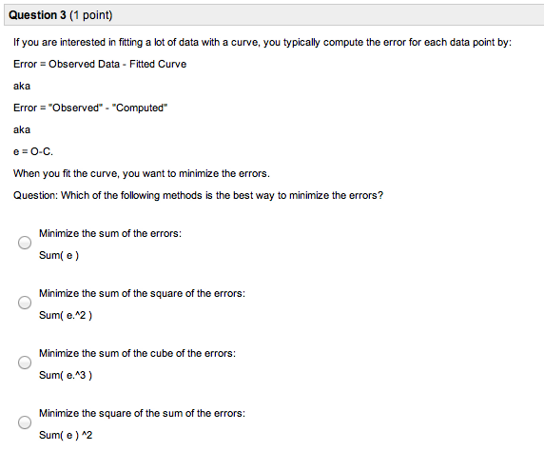
Quiz Results

Slide 10
Quiz Results

Slide 11
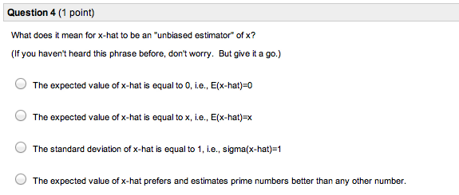
Quiz Results

Slide 12
Quiz Results

Slide 13
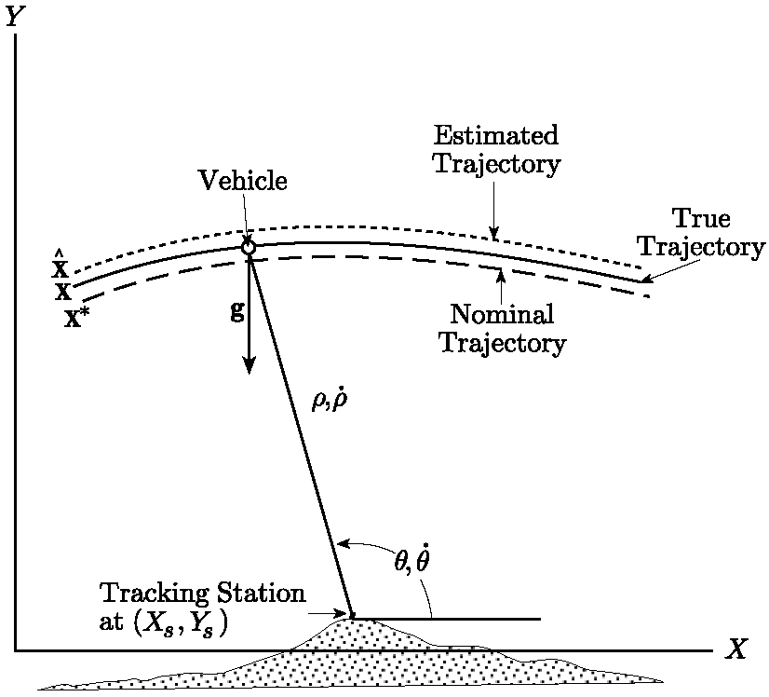
Stat OD in a Nutshell
Truth
Reference
Best Estimate
Observations are functions of state parameters, but usually NOT state parameters.
Mismodeled dynamics
Underdetermined system.

Slide 14

Stat OD in a Nutshell
We have noisy observations of certain aspects of the system.
We need some way to relate each observation to the trajectory that we’re estimating.
X*
Observed Range
Computed Range
True Range = ???

Slide 15
Stat OD in a Nutshell
We have noisy observations of certain aspects of the system.
We need some way to relate each observation to the trajectory that we’re estimating.
X*
Observed Range
Computed Range
True Range = ???
ε = O-C = “Residual”

Slide 16
Stat OD in a Nutshell
Assumptions:
The reference/nominal trajectory is near the truth trajectory.
Linear approximations are decent
Force models are good approximations for the duration of the measurement arc.
The filter that we’re using is unbiased:
The filter’s best estimate is consistent with the true trajectory.

Slide 17
Fitting the data
How do we best fit the data?
Residuals = ε = O-C

Slide 18
Fitting the data
How do we best fit the data?
Residuals = ε = O-C

Slide 19
Fitting the data
How do we best fit the data?
Residuals = ε = O-C
No

Slide 20
Fitting the data
How do we best fit the data?
Residuals = ε = O-C
No
No

Slide 21
Fitting the data
How do we best fit the data?
Residuals = ε = O-C
No
No
Not bad

Slide 22
Fitting the data
How do we best fit the data?
Residuals = ε = O-C
No
No
Not bad

Slide 23
Fitting the data
How do we best fit the data?
A good solution, and one easy to code up, is the least-squares solution

Slide 24
Mapping an observation
How do we map an observation to the trajectory?
X*
Observed Range
Computed Range
ε = O-C = “Residual”

Slide 25
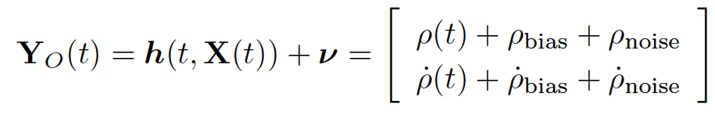
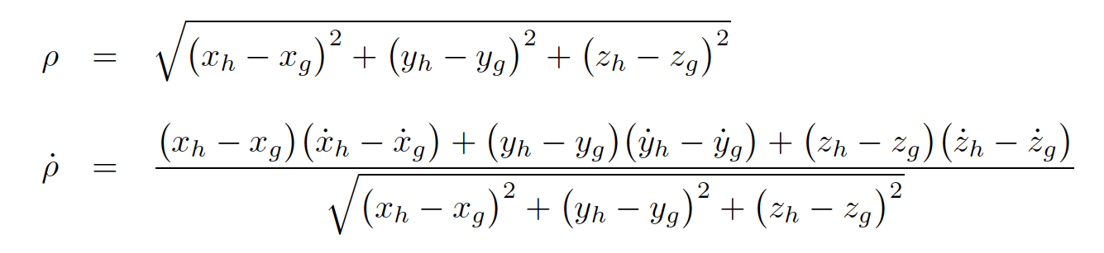
Mapping an observation
How do we map an observation to the trajectory?

Slide 26
Mapping an observation
How do we map an observation to the trajectory?
Very non-linear relationships!
Need to linearize to make a practical algorithm.

Slide 27

State Deviation and Linearization
Linearization
Introduce the state deviation vector
If the reference/nominal trajectory is close to the truth trajectory, then a linear approximation is reasonable.

Slide 28
State Deviation and Linearization
Goal of the Stat OD process:
Find a new state/trajectory that best fits the observations:
If the reference is near the truth, then we can assume:

Slide 29
State Deviation and Linearization
Goal of the Stat OD process:
The best fit trajectory is represented by
This is what we want

Slide 30
State Deviation Mapping
How do we map the state deviation vector from one time to another?
X*

Slide 31
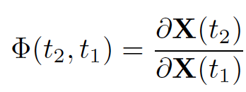
State Deviation Mapping
How do we map the state deviation vector from one time to another?
The state transition matrix.

Slide 32


State Deviation Mapping
How do we map the state deviation vector from one time to another?
The state transition matrix.
It permits:

Slide 33


State Transition Matrix
The state transition matrix maps a deviation in the state from one epoch to another.
It is constructed via numerical integration, in parallel with the trajectory itself.

Slide 34
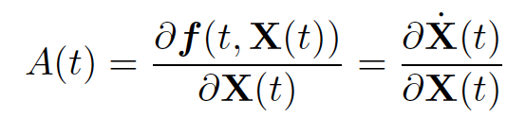
The A Matrix
The “A” Matrix:

Slide 35
Measurement Mapping
Still need to know how to map measurements from one time to a state at another time!

Slide 36

Measurement Mapping
Still need to know how to map measurements from one time to a state at another time!
Would like this:

Slide 37

Measurement Mapping
Still need to know how to map measurements from one time to a state at another time!

Slide 38


Measurement Mapping
Still need to know how to map measurements from one time to a state at another time!
Define:

Slide 39
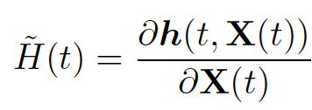
Measurement Mapping Matrix
The Mapping Matrix

Slide 40
Mapping an observation
Now we can map an observation to the state at an epoch.
X*
Observed Range
Computed Range
ε = O-C = “Residual”

Slide 41
How do we solve the problem?
We have the method of least squares

Slide 42
How do we solve the problem?
We have the method of least squares

Slide 43
How do we solve the problem?
We have the method of least squares

Slide 44



How do we solve the problem?
We have the method of least squares

Slide 45
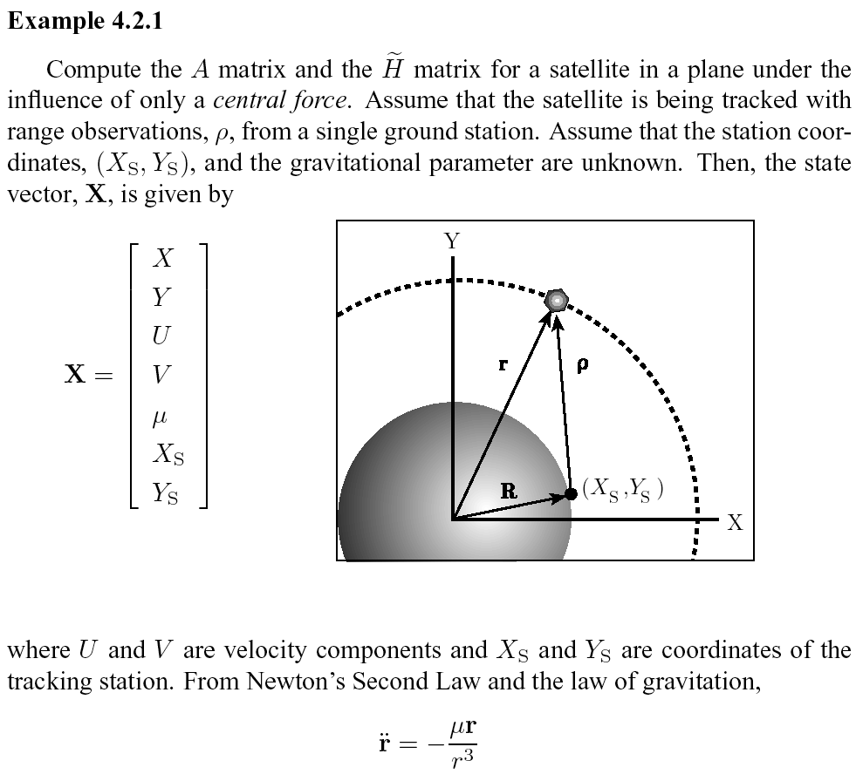
Example 4.2.1

Slide 46



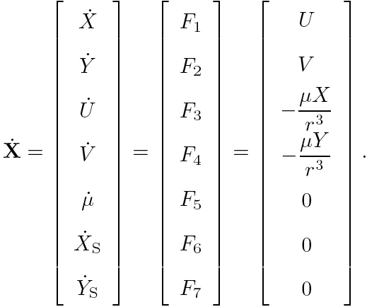
Example 4.2.1
Or in component form:
Expressed in first order form:

Slide 47
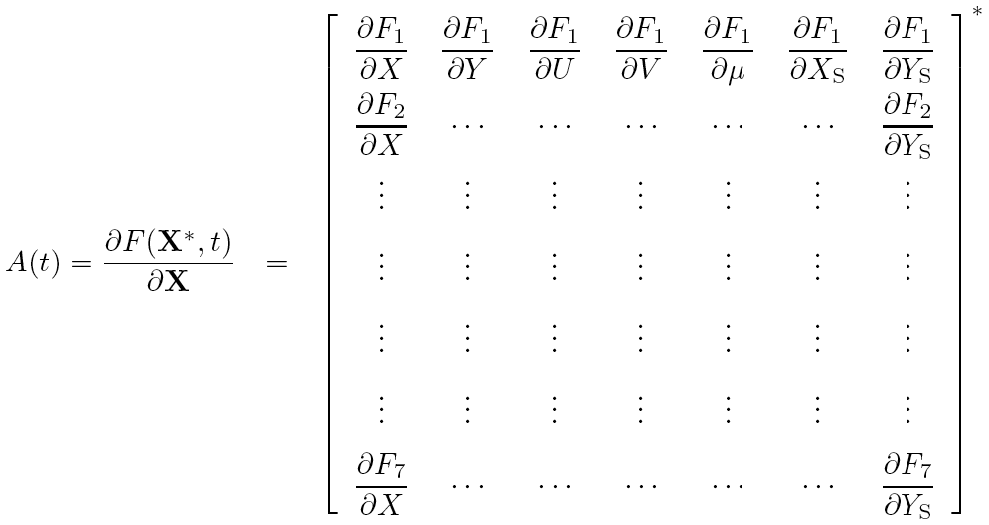
Example 4.2.1

Slide 48
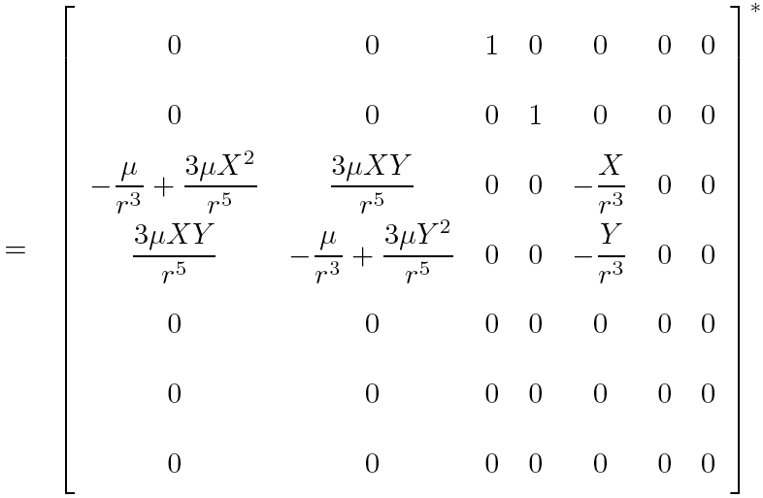
Example 4.2.1

Slide 49
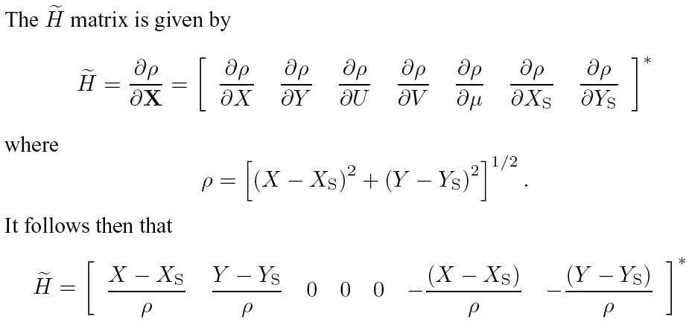


Example 4.2.1

Slide 50
Announcements
Homework 1 Graded
Comments included on D2L
Any questions, talk with us this week
Homework 2 CAETE due Today
Graded soon after
Homework 3 due Today
Homework 4 due next week

